Slide 1





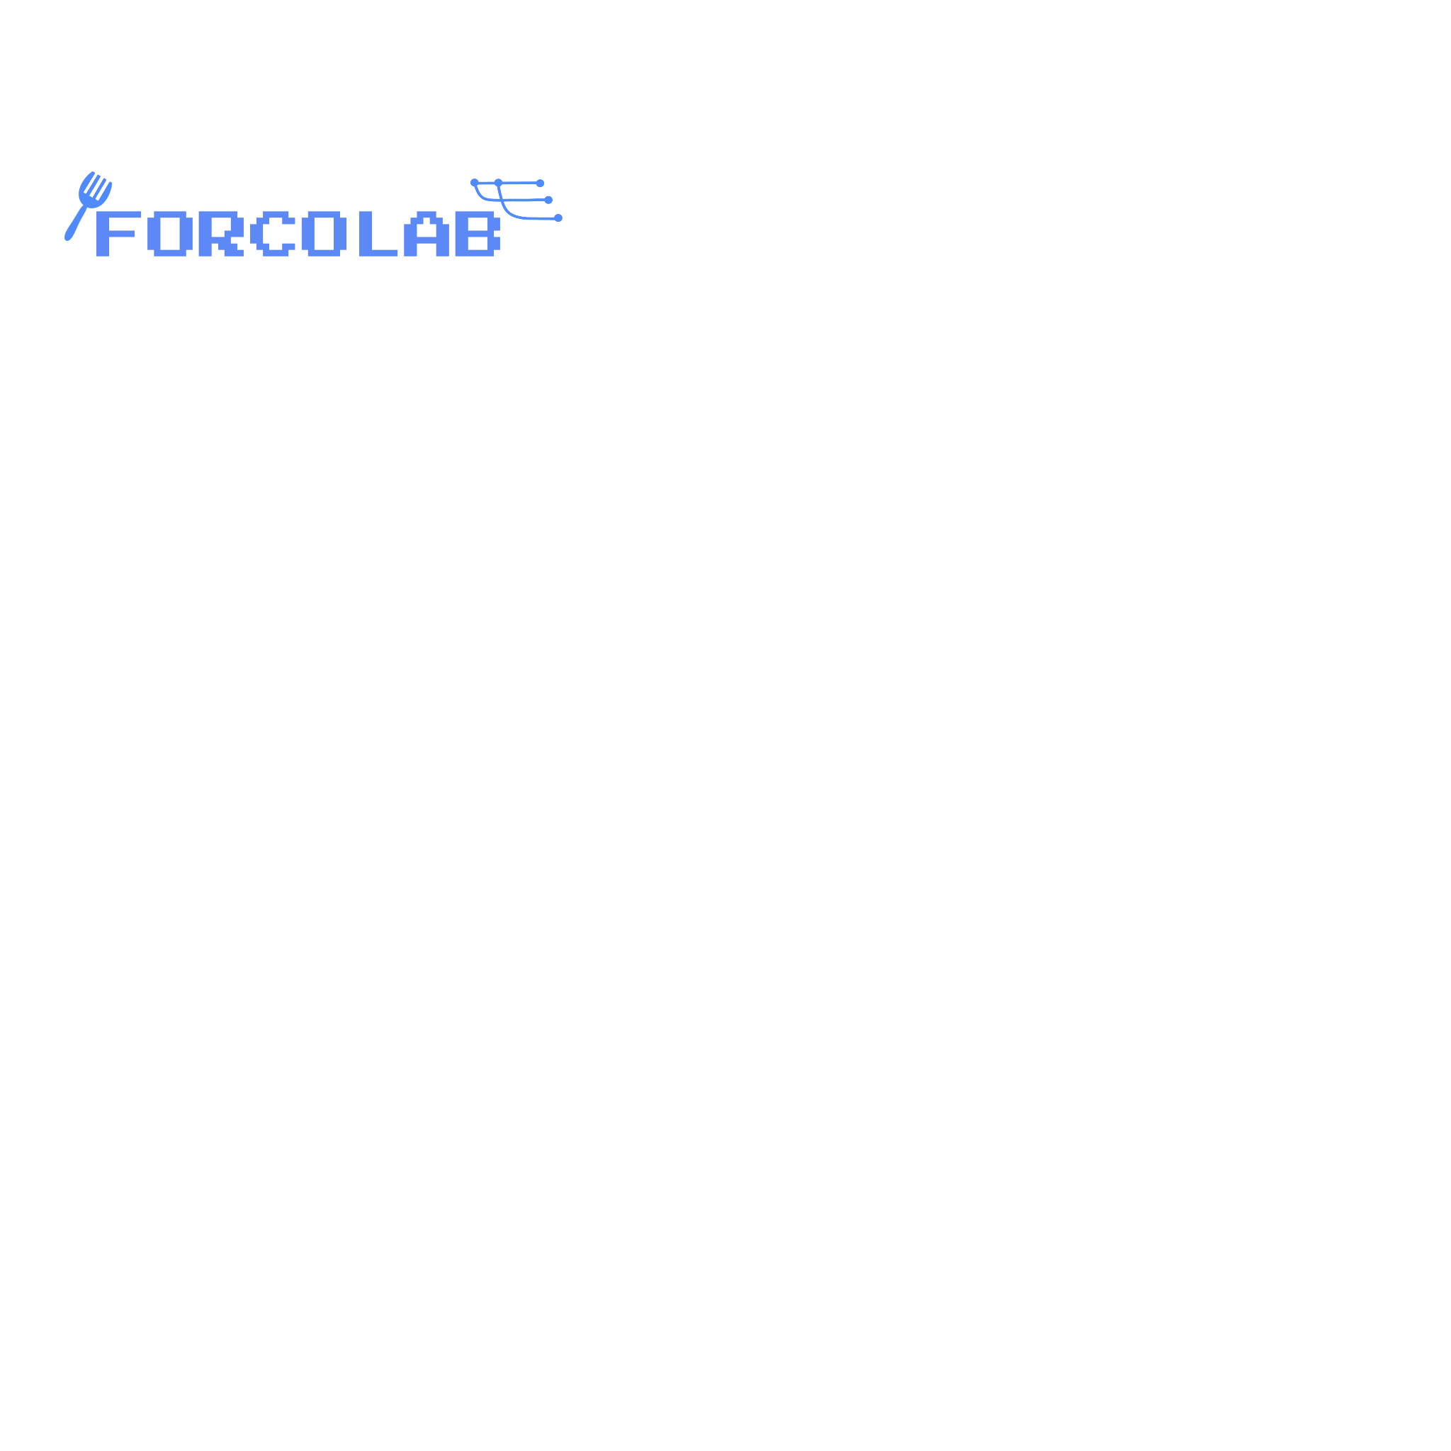
Understanding the Sustainability Challenges for Building Open-Source Scientific Software
Shurui Zhou
Assistant Professor
@shuishuiblue

Slide 2
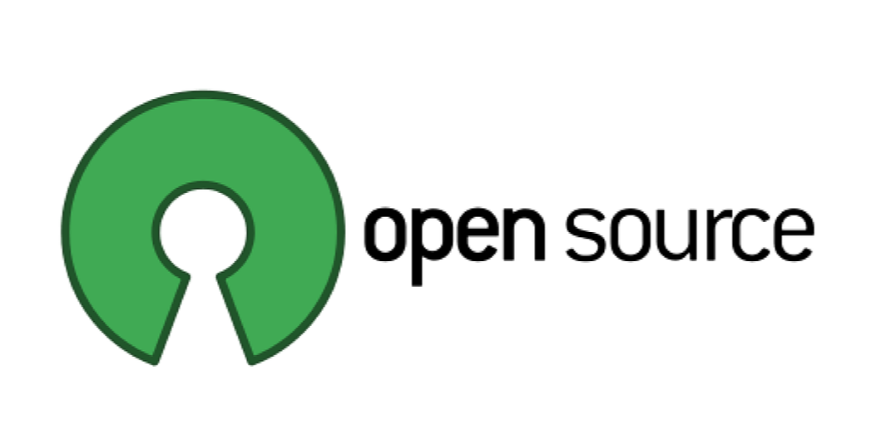


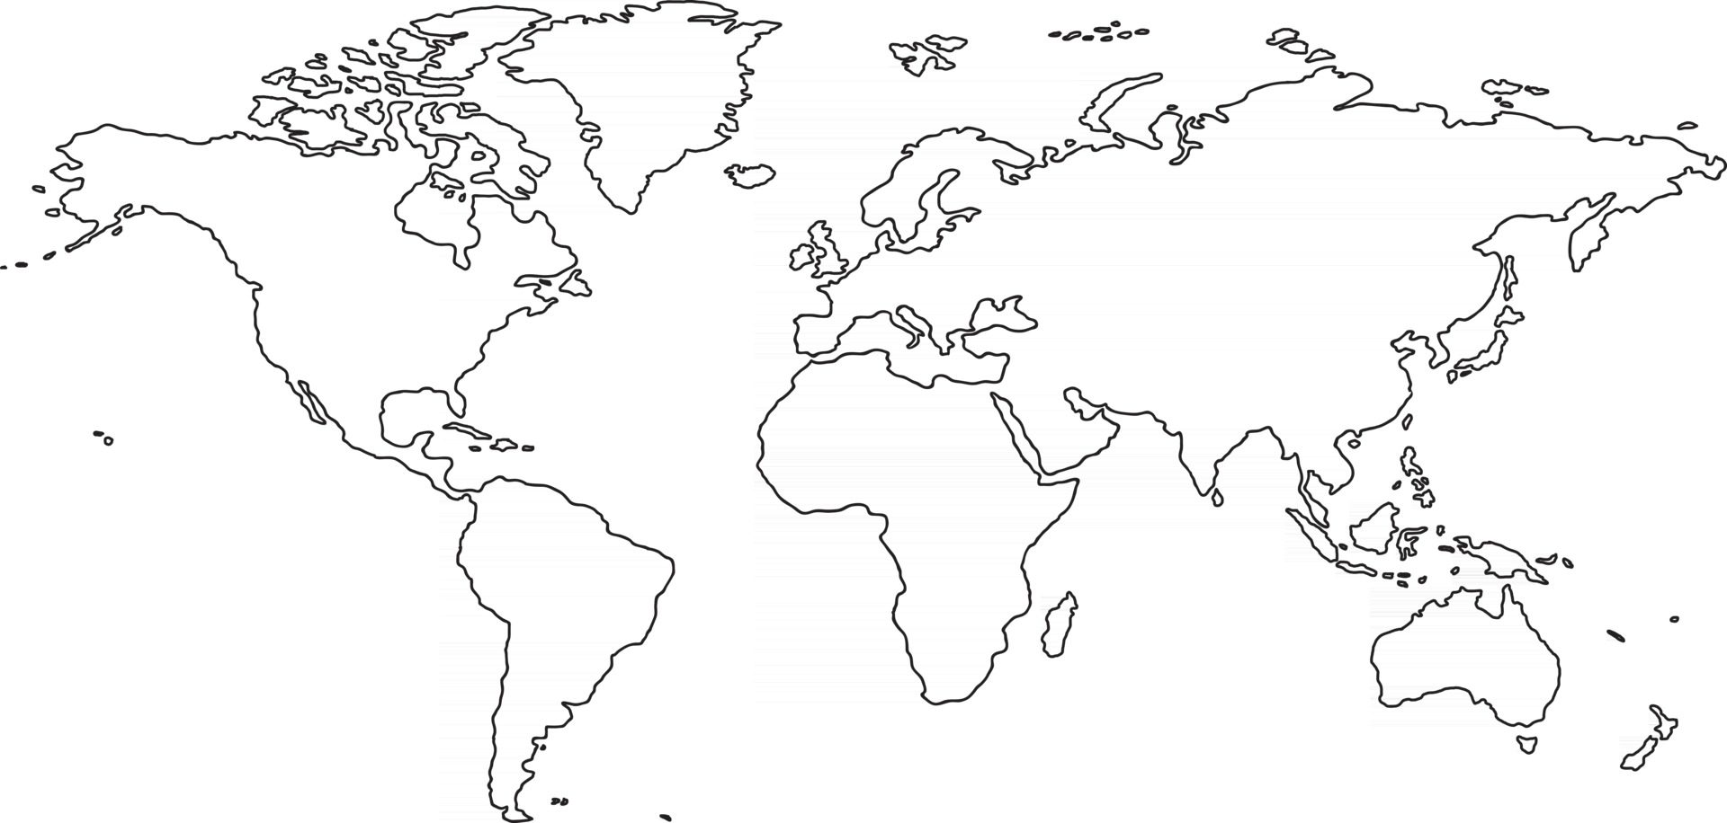








Sustainability Challenges in Open-Source
Sustaining the project
Sustaining the community

Slide 3



Open-Source Scientific Software
Science
Interdisciplinary collaboration

Slide 4
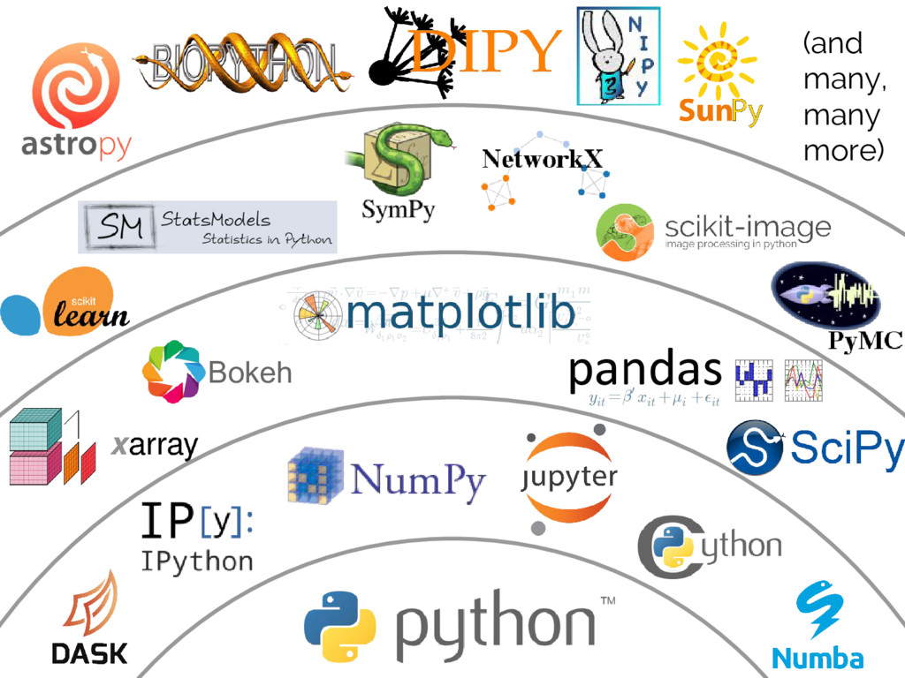
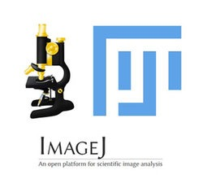


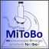

Harris, Charles R., et al. "Array programming with NumPy." Nature 585.7825 (2020): 357-362.
https://github.com/scijava/

Slide 5

Takeaway: Sustainability problem can get worse
Two-fronted risk
Requires both domain-specific knowledge & SE knowledge
Science

Slide 6
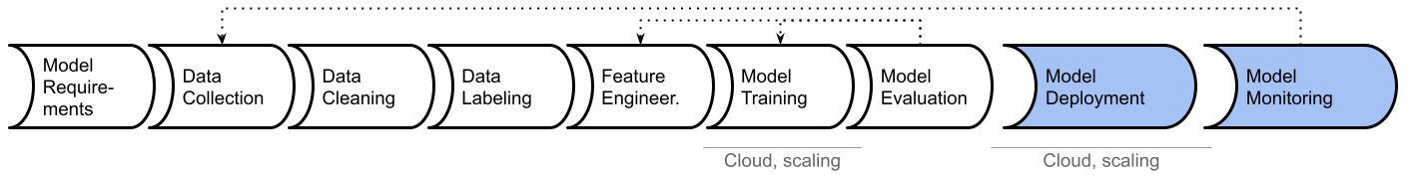


From Model to Production
Interdisciplinary Collaboration when building AI-based Software
Different experts tend to focus on different stages in the machine learning lifecycle
[1] Nahar et al. Collaboration Challenges in Building ML-Enabled Systems: Communication, Documentation, Engineering, and Process. ICSE 2022.

Slide 7
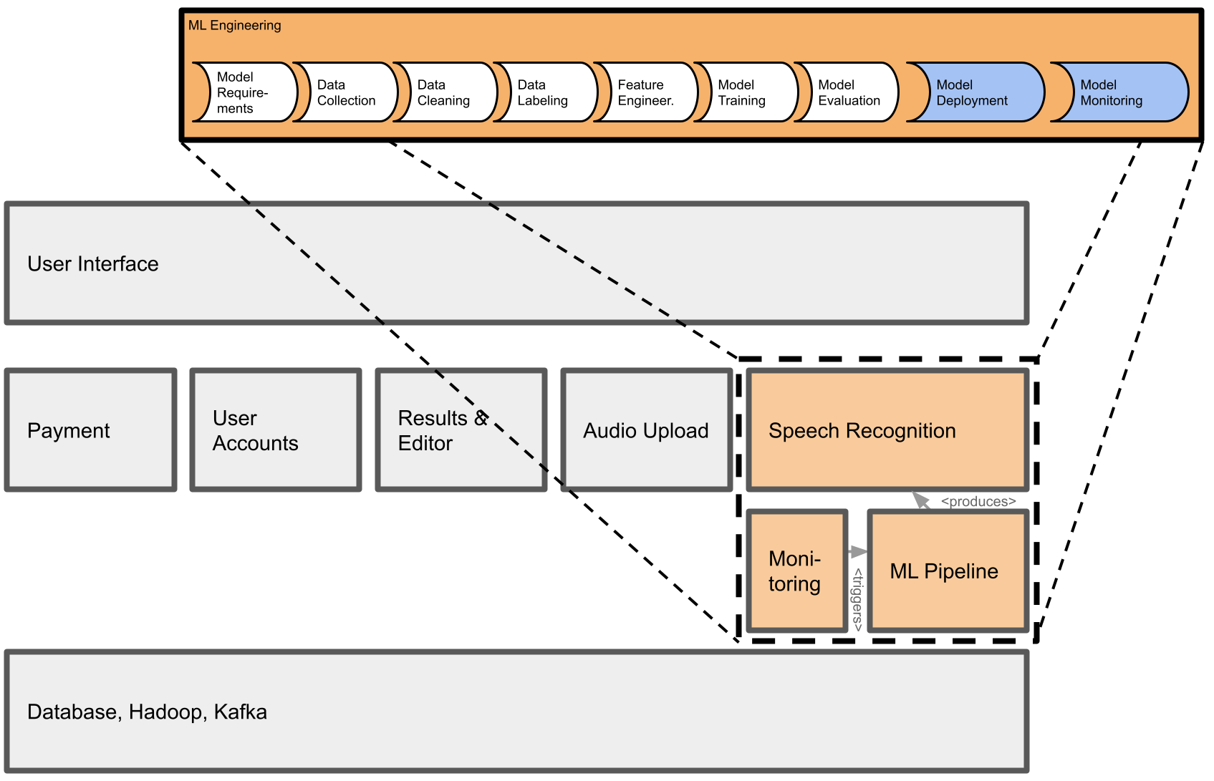

Interdisciplinary Collaboration when building AI-based Software
From Model to Production
MLOps
User Interface
User
Account
Results &
Editor
Audio
Upload
Speech
Recognition
Payment
Moni-
toring
ML
Pipeline
Database, Hadoop, Kafka

Slide 8
Our Focus: Sustainability Challenges when Building Scientific Software in Open-Source
Majority of development work is done by scientists
Professional SDE may be employed to create and maintain the software
[2] Kelly et al. 2015. Scientific software development viewed as knowledge acquisition: Towards understanding the development of risk-averse scientific software. Journal of Systems and Software.
[3] Katherine A. Lawrence. Walking the Tightrope: The Balancing Acts of a Large e-Research Project. CSCW 2006.

Slide 9

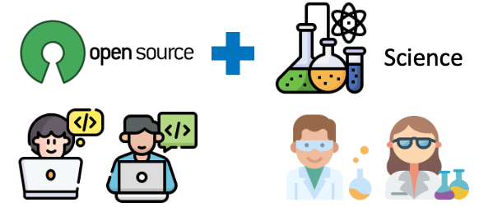
Q1
What are the major obstacles when an interdisciplinary team builds and maintains a scientific OSS?

Slide 10
Q2
What are the main factors for sustaining the scientific OSS community?

Slide 11

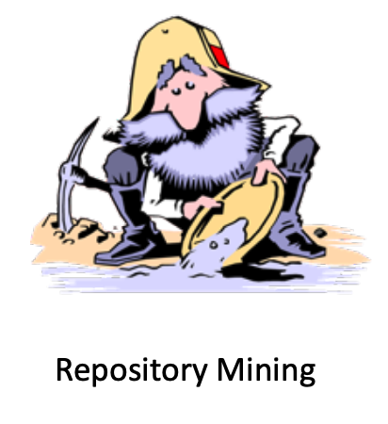

A Case Study on a scientific software in Physics domain
Q1
Science-related challenges in OSS context
Interview
Mining
Repositories
Q2
OSS-related challenges in scientific comm.
Survey

Slide 12

A brief intro of Moonpie
A software ecosystem
1 core package & 50 interoperable packages
Core package has 1.6K forks
Over 10 years
The project has been cited over 5.5K times
41 core contributors
> 400 contributors in total

Slide 13
A Case Study on a scientific software in Physics domain
Q1
Science-related challenges in OSS context
Interview
Mining
Repositories
Q2
OSS-related challenges in scientific comm.
Survey

Slide 14
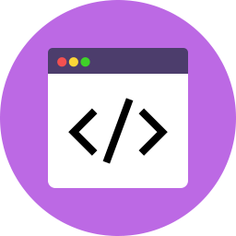
Q1: Science-related challenges in OSS context
Focusing on 41 core contributors
Understanding the type of contributions
The code file can be divided into 2 categories:
Infrastructure
Domain-specific

Slide 15
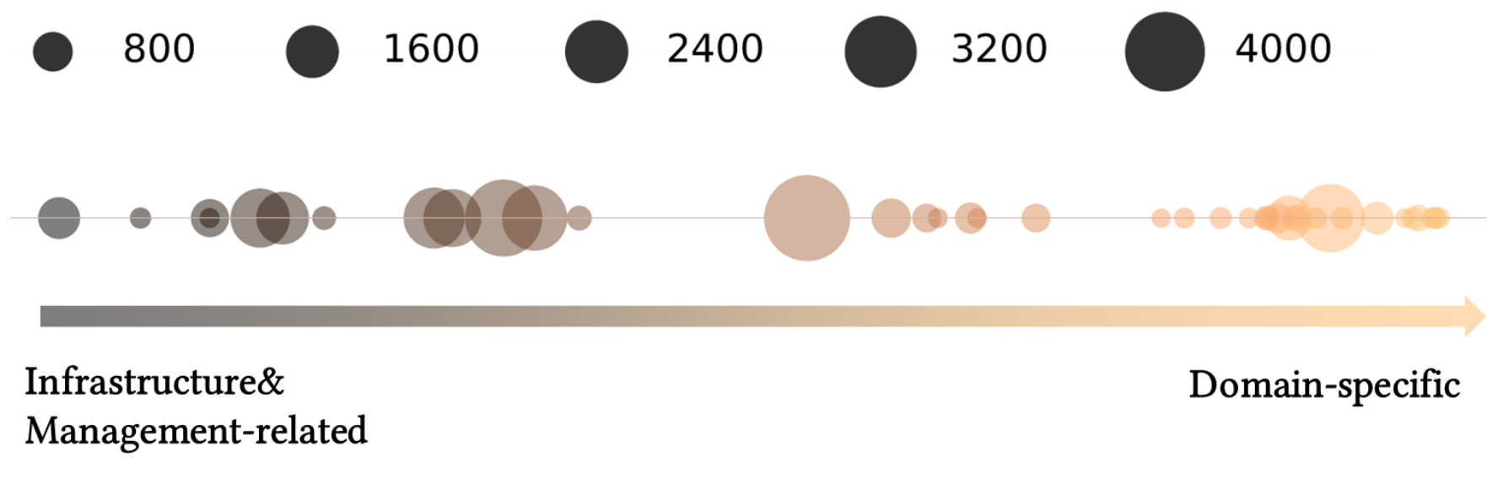
Q1: Science-related challenges in OSS context
number of merged commits

Slide 16


Q1: Science-related challenges in OSS context
number of merged commits

Slide 17
Conflicts between different mindsets
Incentives of making contribution
Prioritizing the tasks
“rigid coding standards... they need to accept the flexible nature of scientific software collaboration”

Slide 18
Conflicts between different mindsets
Perception of seniority
“senior researchers in the decision-making position sometime ignore certain PRs because they do not see the value of the research."

Slide 19
A Case Study on a scientific software in Physics domain
Q1
Science-related challenges in OSS context
Interview
Mining
Repositories
Q2
OSS-related challenges in scientific comm.
Survey

Slide 20

Q2: OSS-related challenges in scientific community
Survey questions to disengaged contributors:
incentive
reason of disengagement
suggestion of improving sustainability

Slide 21
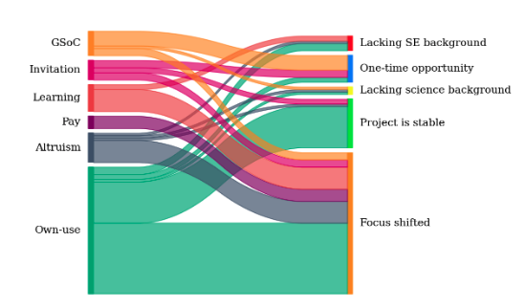
Incentives
Reasons for disengagement

Slide 22


Slide 23

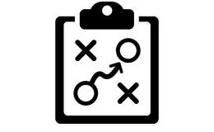
We need a different strategy

Slide 24

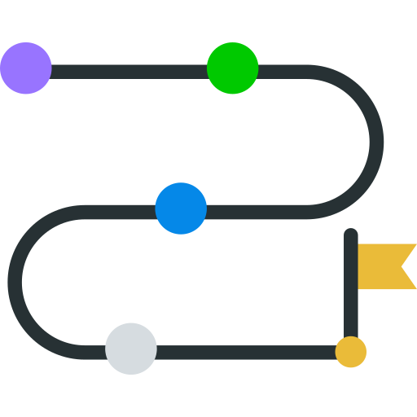


Lowering the entry barrier in science
We need a different strategy
Make both SE and science more accessible
Documentation for source code and scientific theory
More guidance on Good First Issues
Tooling support?
GFI

Slide 25



Recognizing the participation and contribution
We need a different strategy
Citing the tool you are using
Acknowledging the impact of contribution
Quantifying the impact?
Identify the usage in a large scale

Slide 26
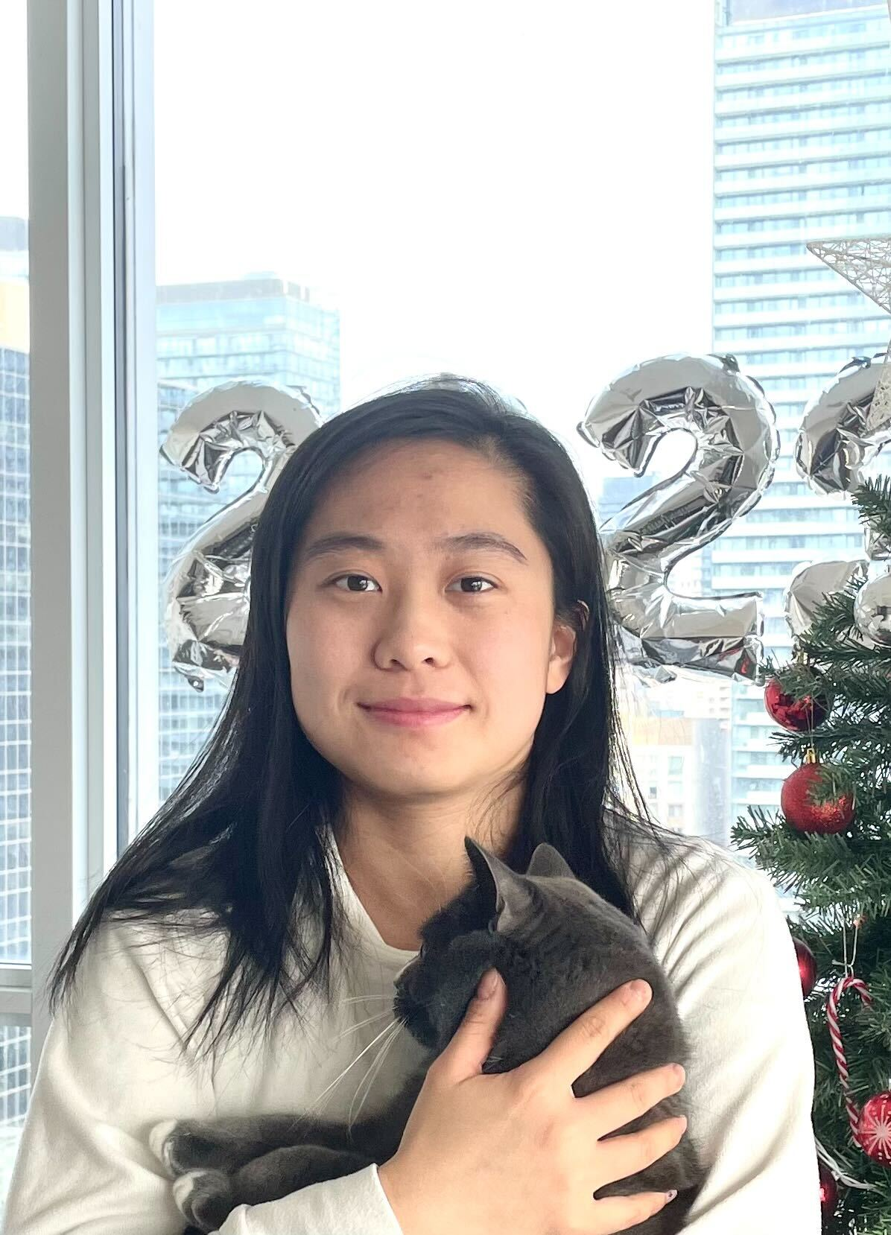
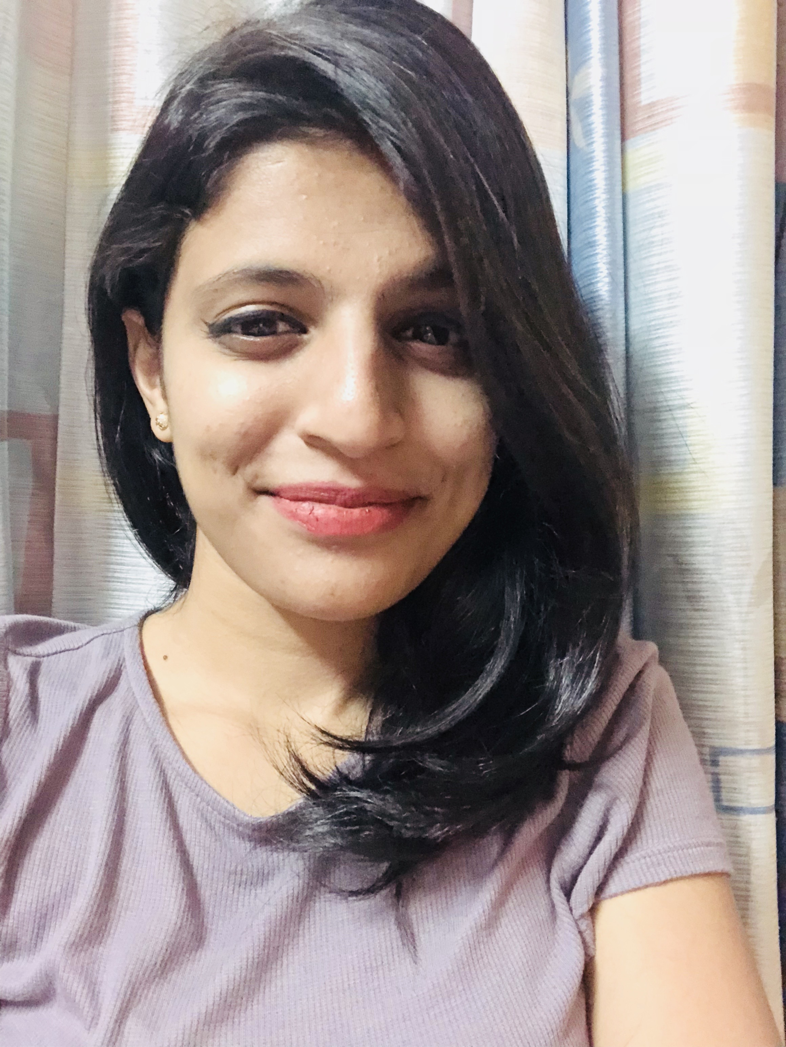

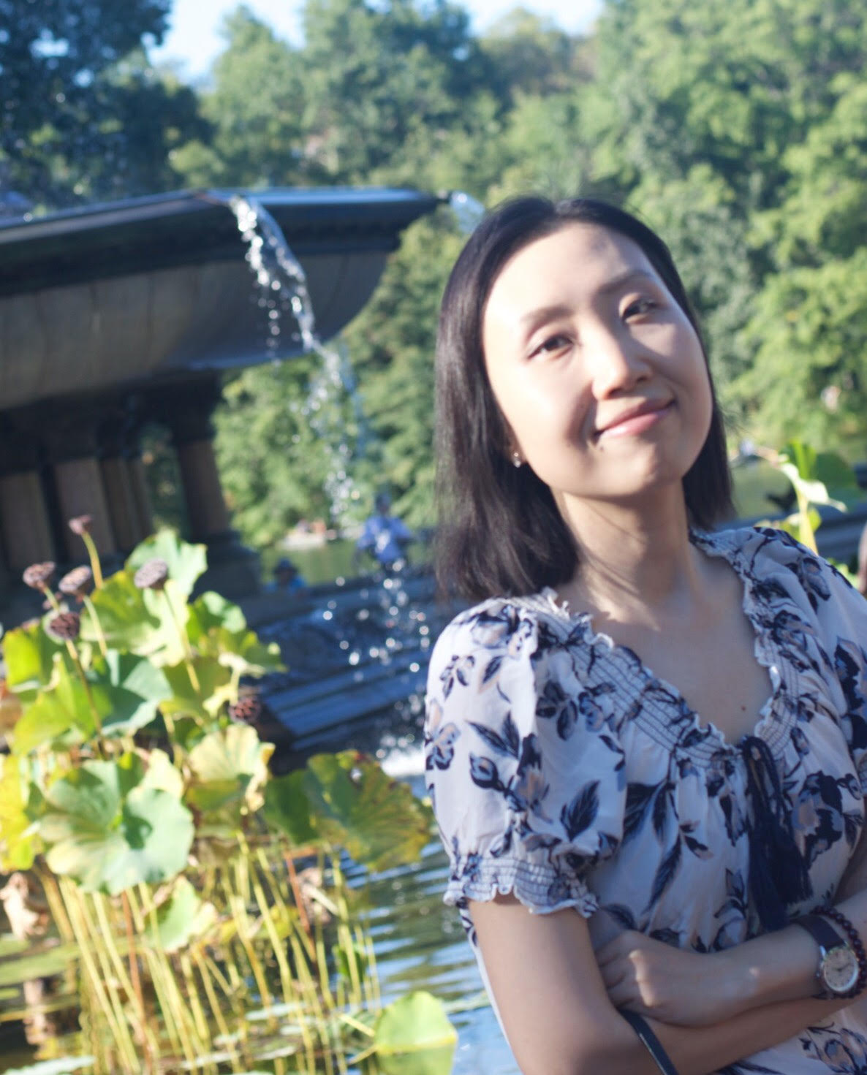

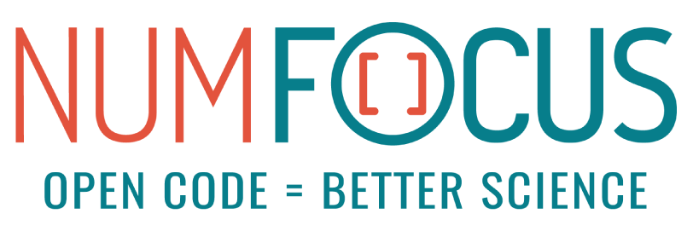
Acknowledgement
Jiayi Sun
PhD student
U of Toronto
Aarya Patil
PhD student
U of Toronto
Youhai Li
Undergrad
U of Toronto
Jin Guo
Professor
McGill University

Slide 27
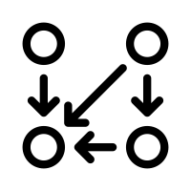
Understanding the Sustainability Challenges for Building Open-Source Scientific Software
Recognize the unavoidable tension
Improving accessibility for both code and science
Shurui Zhou
@shuishuiblue
Giving credits to the contribution

